Slide 1
Presentation Of Awareness Of Phishing Attack

Slide 2
CONTENTS
Introduction
What is Phishing
How does phishing work?
What the are dangers of phishing attacks?
Phishing Examples
The different flavor of Phishing attack
Types of Phishing
How do I protect against phishing attacks?
Causes of Phishing
Effects of Phishing
Conclusion
Reference

Slide 3
INTRODUCTION
Phishing is the most powerful and popular attack forhacking into emails and web accounts.
Cyber criminals use this attack to hack into bankaccounts, Facebook accounts and email account ofinnocent people.
Every year, most of the biggest cyber crime caseinvolve this attack.
So we must know what is Phishing and how toprotect your accounts from phishing attack.

Slide 4
WHAT IS PHISHING?
Phishing is the act of fooling a computer user into submitting personal information by creating a counterfeit it website that looks like a real (and trusted)site.
It is a hacker technique of "fishing" for passwords and other secret financial info.

Slide 5
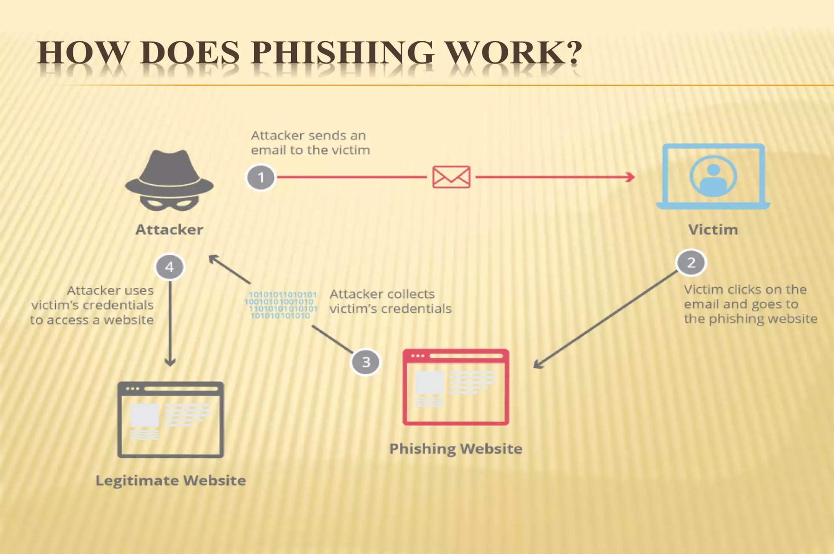

Slide 6
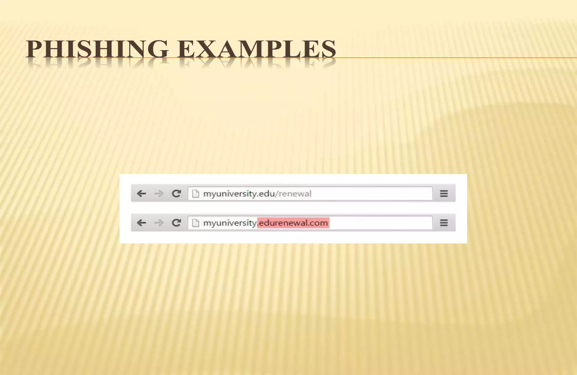

Slide 7
TYPES OF PHISHING:
1) Deceptive phishing
2) Spear phishing
3) Whaling
4) Pharming

Slide 8
WHAT THE ARE DANGERS OF PHISHING ATTACKS?
Sometimes attackers are satisfied with getting a victim's credit card information or other personal data for financial gain.
Other times, phishing emails are sent to obtain employee login information or other details for use in an advanced attack against a specific company.

Slide 9
HOW DO I PROTECT AGAINST PHISHING ATTACKS?
User education
One way to protect your organization from phishing is user education.
Education should involve all employees.
High-level executives are often a target Teach them how to recognize a phishing email and what to do when they receive one.
Simulation exercises are also key for assessing how your employees react to a staged phishing attack.

Slide 10
CAUSES OF PHISHING
Misleading e-mails No check of source address
Vulnerability in browsers No strong authentication at websites of banks and financial institutions Limited use of digital signatures
Non-availability of secure desktop tools Lack of user awareness
Vulnerability in applications

Slide 11
EFFECTS OF PHISHING
Internet fraud
Identity theft
Financial loss to the original institutions Difficulties in Law Enforcement Investigations
Erosion of Public Trust in the Internet.

Slide 12
CONCLUSION
No single technology will completely stop phishing.
However, a combination of good organization and practice, proper application of current technologies, and improvements in security technology has the potential to drastically reduce the prevalence of phishing and the losses suffered from it.

